Slide 1






CatSat: Ground Station Assembly and Mission Operations
Sarah Li
Dr. Christopher Walker, University of Arizona
Arizona NASA Space Grant Consortium Student Research Symposium
Tucson, Arizona
April 20, 2024
Notes:
Introduction

Slide 2

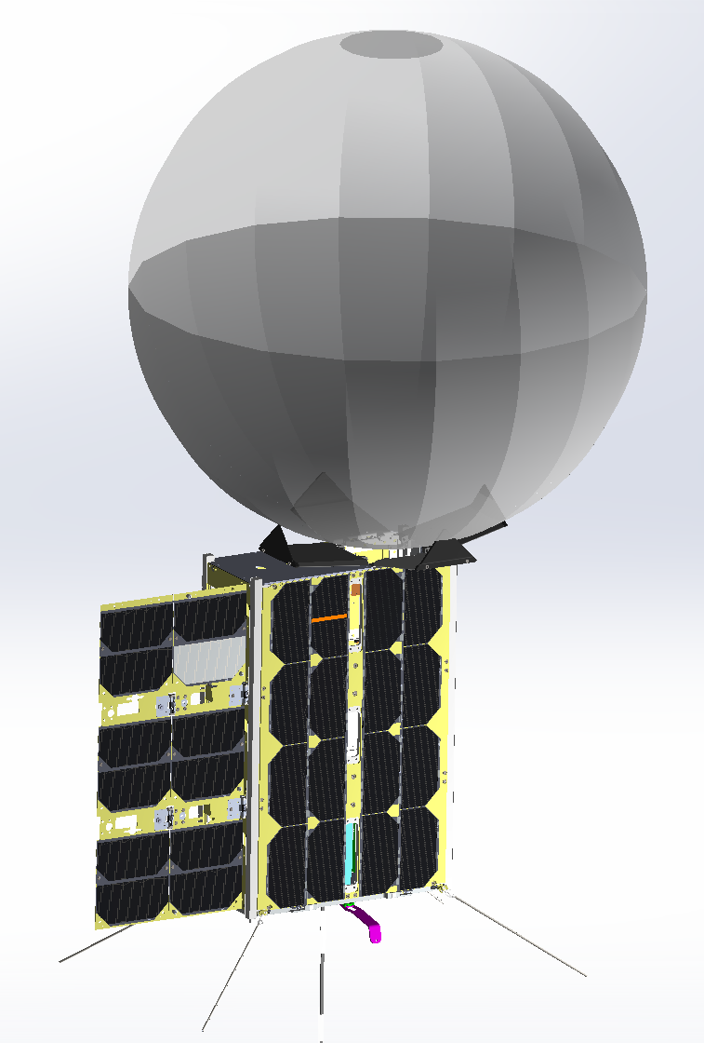
High-bandwidth Communications for Small Satellites
Small satellites traditionally face limitations in communication capabilities due to size and mass constraints.
Advancement of inflatable antenna systems on small satellites will support high bandwidth communications for interplanetary small-satellite and CubeSat missions.
The University of Arizona’s CatSat, a 6U CubeSat, focuses on demonstrating the first inflatable antenna from Low Earth Orbit (LEO).
Notes:
Small satellites currently face limitations in their communication capabilities due to size and mass constraints imparted on these systems.
Typical small satellite antennas are rigid and occupy a large volume of space. These antennas typically have limited gain (the deg. to which an antenna concentrates/absorbs radiated/incident power to/from a direction) and effective bandwidth.
Inflatable antenna systems, such as CatSat’s, can be packed in a small volume and provide greater gain and bandwidth capabilities, resulting in transfer of high data volumes at high data rates.
CatSat’s inflatable antenna is expected to provide up to 50 Mbps (megabits per second) downlink speeds from LEO via X-band frequencies (~10.47 GHz).
---------------------------------------------------------------------------------------------------------------------------------------------------------------------------------------------------------------------------------------
Note: CatSat’s inflatable antenna is made of Mylar film with one hemisphere metallized and the other half clear.

Slide 3
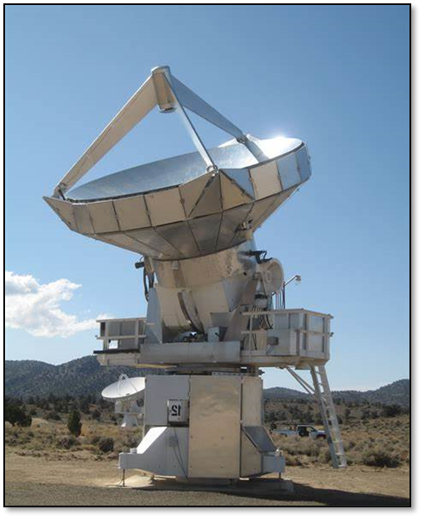
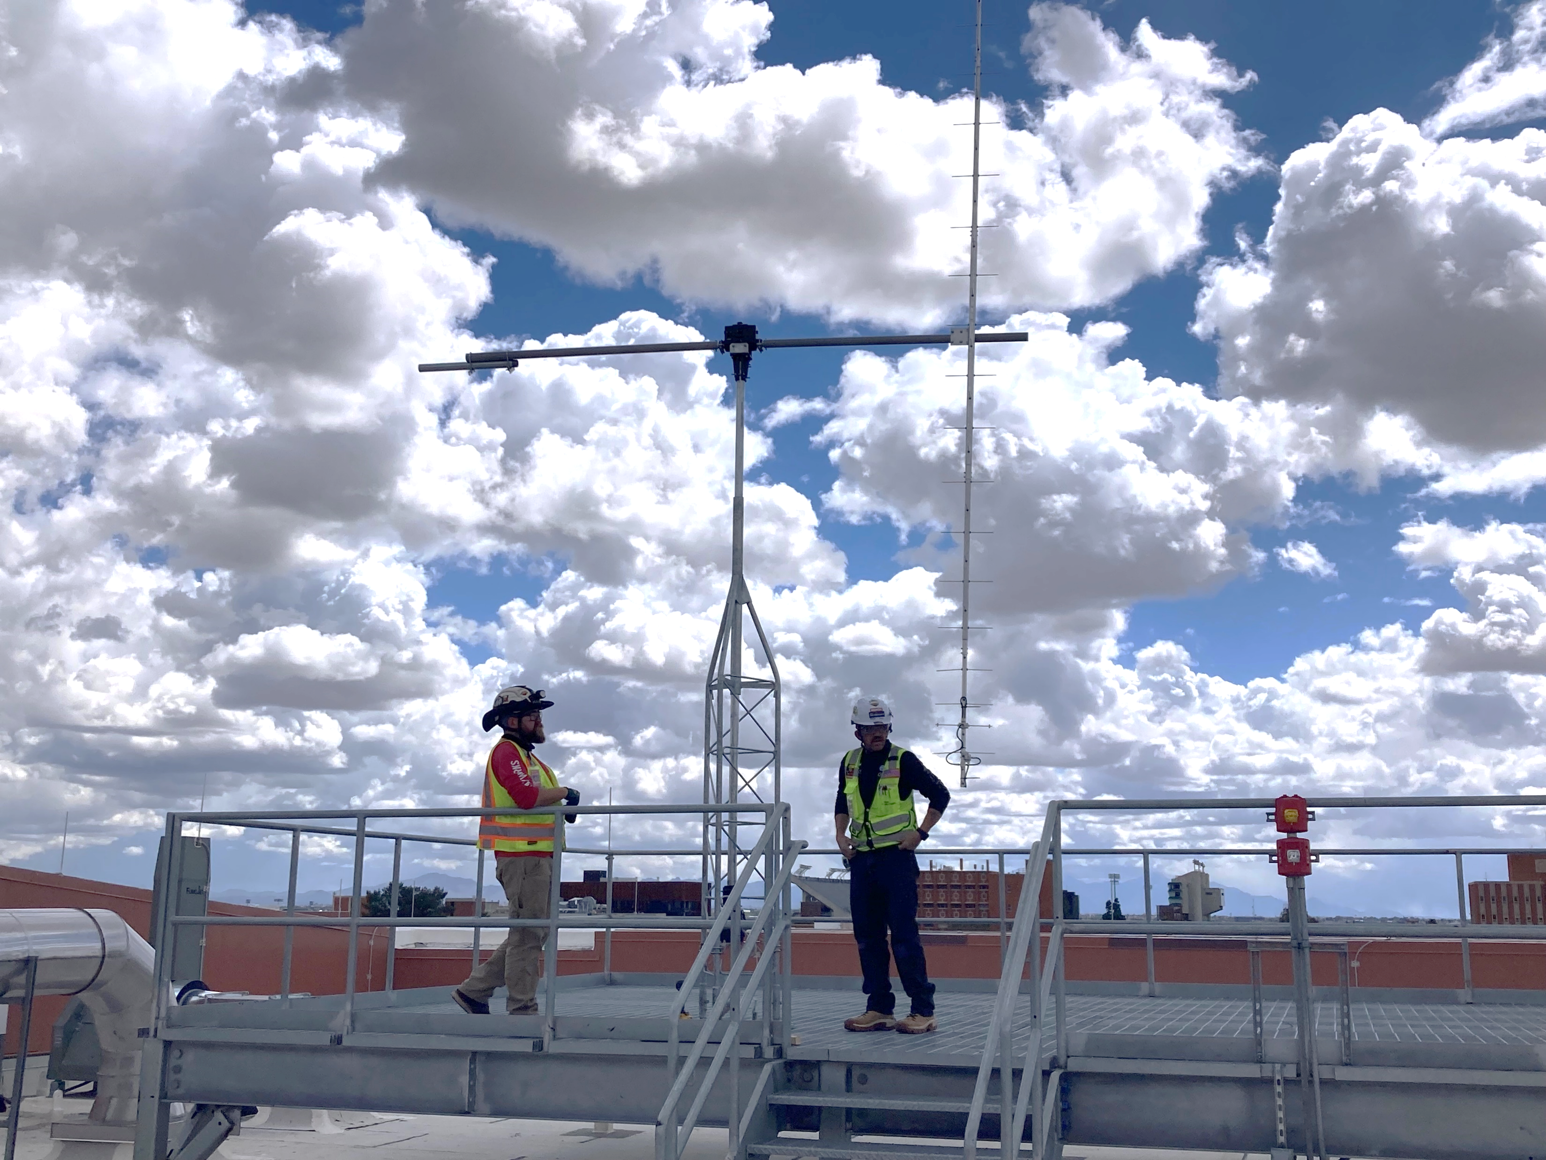
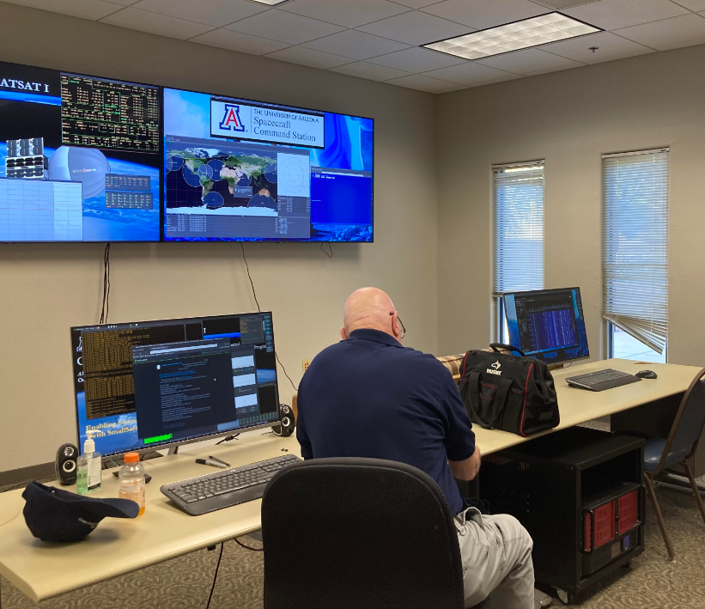
Preparing for CatSat’s Operations
As of November 2022, CatSat is fully qualified and ready for launch...
Mission Operations Preparation
  Ensuring spacecraft safety during Launch and Early Orbit (LEOP)
  Spacecraft checkout procedures
  Creating spacecraft command scripts
  Scheduling ground communications
Ground Station Construction
  Ultra-high frequency (UHF) ground station at the Applied Research Building (ARB)
  Survey of Biosphere 2
  Rincon Research Corporation (RRC) & UA Cooperation
Science Operations Preparation
  Defining science objectives
  Scheduling science operations
  Storing and publishing CatSat’s data
My focus areas…
Notes:
Since November 2022, CatSat has been fully qualified and ready for launch.
If you’ve been to a few of these symposiums, you’ve probably seen various iterations of this presentation at this point.
However, we are anticipating a very near integration and launch date, which means the team is focusing their efforts on three areas of the program including mission operations, science operations, and ground station construction.
Across all three areas, it’s been largely a collaborative effort, but my focus for this year was on ground station construction and defining our science operations.

Slide 4
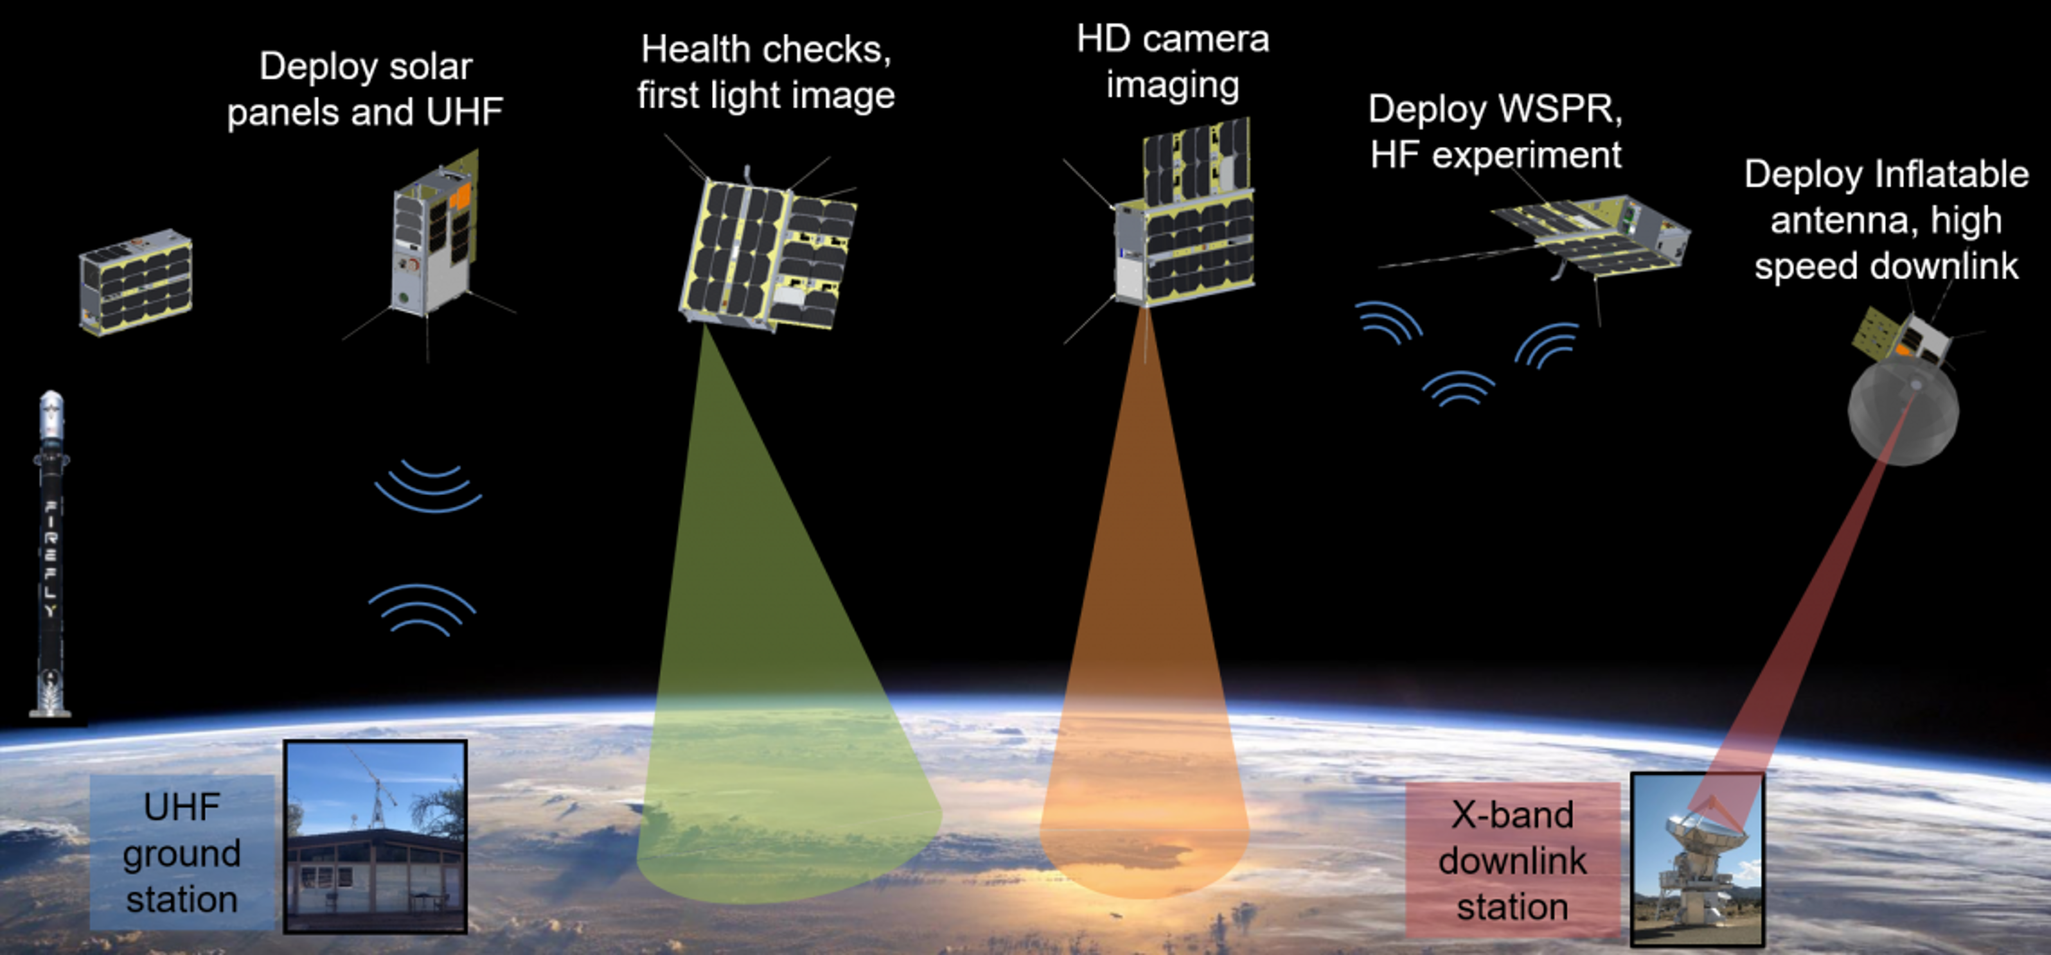
Review of CatSat’s Concept of Operations
Diagram: UA CatSat Website (2024)
Notes:
Before I jump into those activities, I wanted to provide a brief overview of CatSat’s concept of operations as a framework for you all.
From the steps that you see here in the ConOps, I’ve highlighted our command-and-control UHF GS and our downlink X-band GS. The reason being is that before we can execute any of our initial operations, we need a way to communicate with our satellite and receive its data, which is achieved through our ground stations.
--------------------------------------------------------------------------------------------------------------------------------------------------------
Back-up:
Generally speaking, after CatSat separates from the launch vehicle, we will power on the onboard flight computer and deploy solar panels and the UHF antennas to establish ground comms.
We will attempt to take our first on-orbit picture and continue health checkouts until are systems are operational.
Following, we will test several instruments including the HDCam and downlinking high-definition images of Earth through a 10GHz patch antenna. If functional, the WSPR antenna (Weak Signal Propagation Reporter) will deploy and detect (high-frequency) HF signals from amateur radio stations. The data from the WSPR antenna will also be downlinked initially through the 10 GHz patch antenna.
After all previous systems are checked out, the inflatable antenna will be deployed last, and all data will be downlinked by the inflatable antenna instead of the 10 GHz patch antenna.
---------------------------------------------------------------------------------------------------------------------------------------------------------Note: The WSPR antenna is designed to detect WSPR signals from amateur radio stations across the world. WSPR transmissions typically consist of the location of the transmission and the power of the device transmitting the signal. We can compare the transmitted information with the way the signal actually arrives at CatSat’s receiver.

Slide 5
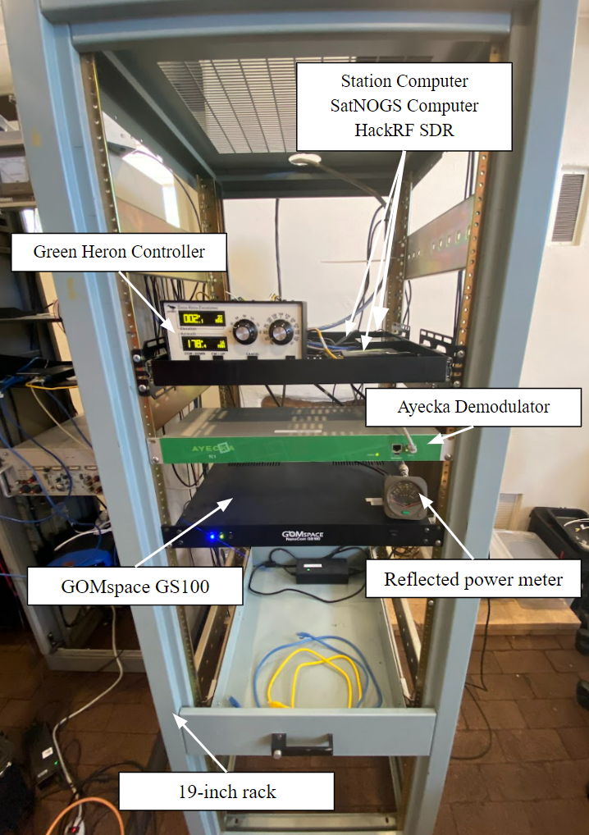
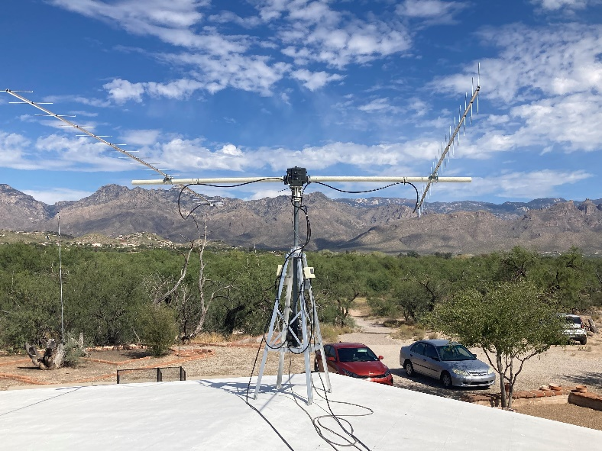
Command & Control UHF Ground Station
Horizontally Polarized Yagi Antenna
Vertically Polarized Yagi Antenna
Station Computer, SatNOGS Computer, HackRF SDR
Cross Boom
Green Heron Rotator Controller
2 LNAs (Low Noise Amplifiers)
Rotators for Az/El
Ayecka Demodulator
GOMspace GS100
Reflected Power Meter
Antenna Tower
Images:
(Left) Radio Ranch antenna and tower set-up
(Right) Radio Ranch control room set-up by Shae Henley & Walter Rahmer
19-inch Rack
Notes:
UHF communications concern sending commands to CatSat and receiving the satellite’s telemetry data (data that travels from a spacecraft to Earth, this can reveal attitude data, power usage, images from the metrology cameras (positioned to see edges of the inflatable antenna). The downlink and uplink frequency for UHF communications with CatSat is 437.185 MHz.
Until recently, Radio Ranch had been the primary UHF GS for the program, which is pictured above.
This station serves as the reference UHF GS for our new primary GS at the ARB.
--------------------------------------------------------------------------------------------------------------------------------------
Back-up:
Two operations concerning UHF communications:
Telemetry data from the onboard flight computer is modulated into a UHF signal by the onboard radio (AX-100 operating between 435-438 MHz) and transmitted by the satellite’s UHF antenna.
Signals from the ground like software updates and telecommands are transmitted to the satellite and received by its UHF antenna, which is also demodulated by its onboard radio.
--------------------------------------------------------------------------------------------------------------------------------------
Essential Contents Inside Rack:
GS100 Radio - Primary radio to communicate with the spacecraft
Green Heron Controller - Alt/Az controller for the antenna pointing. Provides control signals and power for the rotators.
Station Computer - Operation hub for the station, handles data forwarding and external connections
Auxiliary Contents Inside Rack:
SatNOGS Computer - Computer to connect this ground station to the SatNOGS network
HackRF SDR - Software defined radio for the SatNOGS computer
Reflected Power Meter - Measurement device for antenna functionality
Ayecka Demodulator – demodulate downlinked data through x-band
Description of Cabling:
Alt(El)/Az Cable Bundle - Thick cable bundle connecting power and control between the Green Heron and the antennas. Cable is estimated to be approximately 1-2 inches in diameter. One cable bundle carries both sets of cables
2 Runs of LMR400 RF cable - One for each Yagi antenna, both connected directly to the GS100

Slide 6
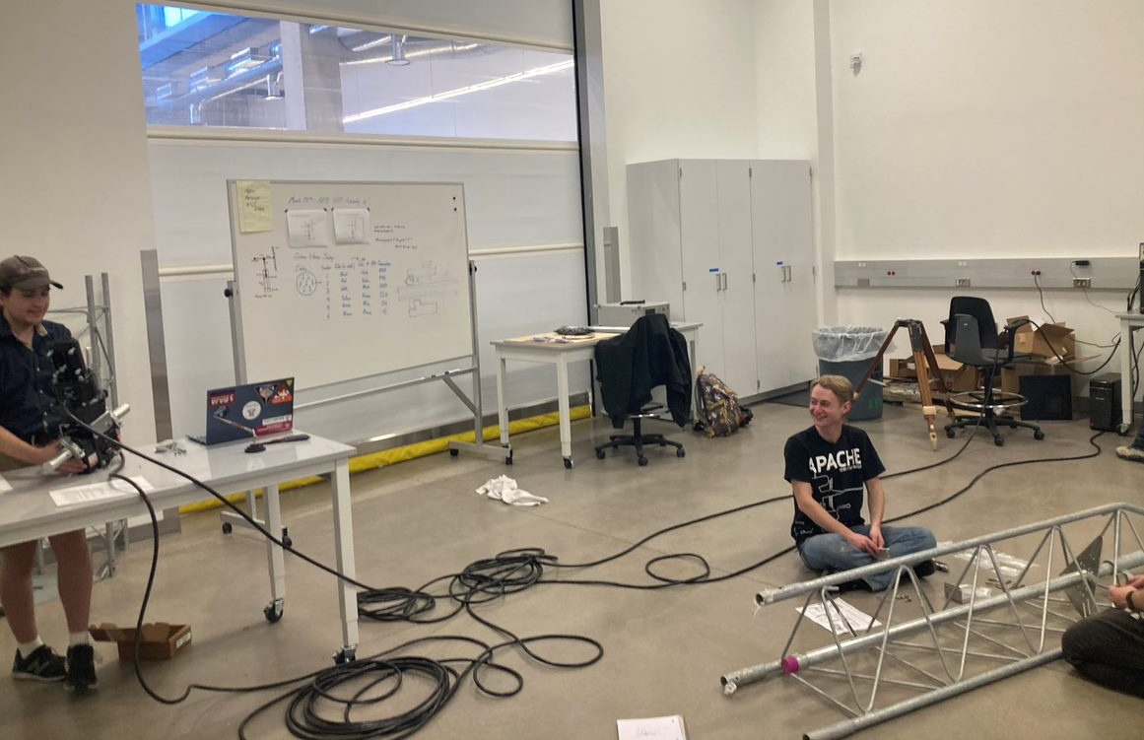
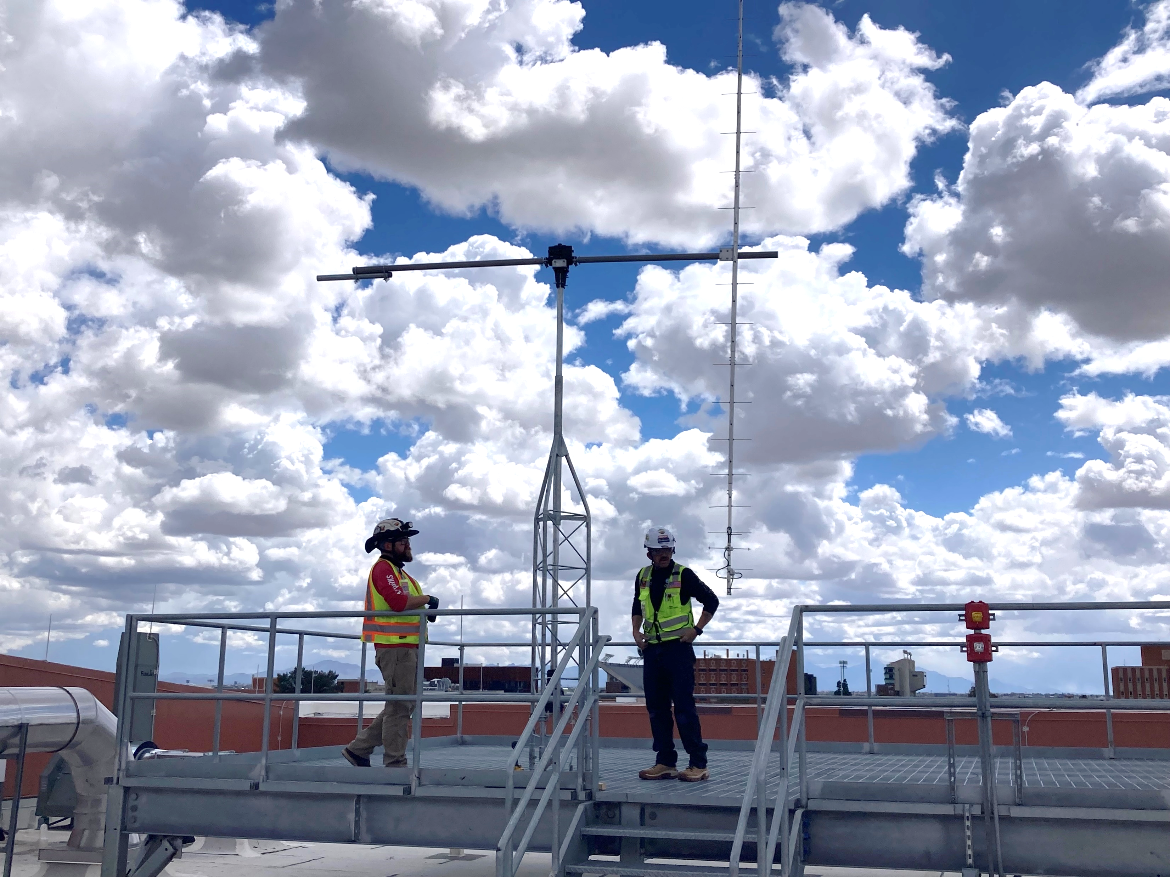
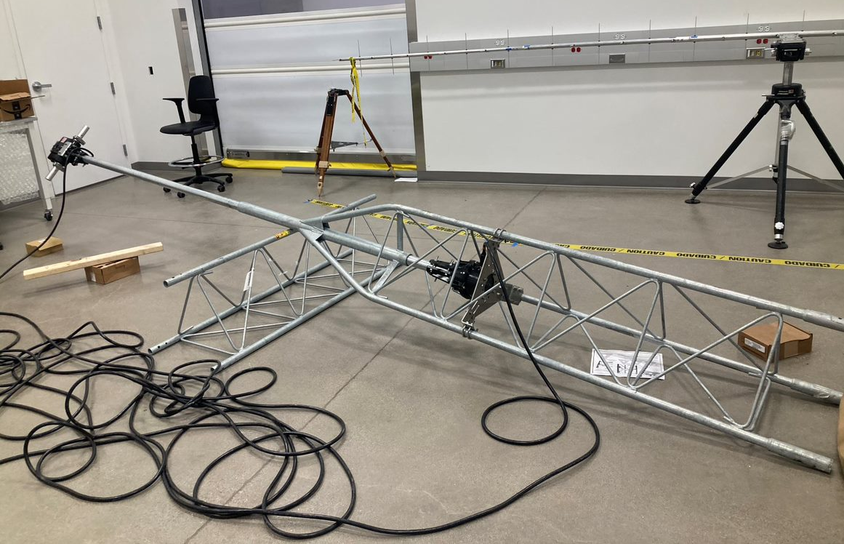
Command & Control UHF Ground Station
Circularly Polarized Yagi Antenna
Counter-weight
Rotators for Az/El
Image: Initial tower and antenna mounting completed by McCarthy Building Companies
Notes:
Assembling the UHF GS at the ARB has been a collaborative effort across our student team.
The initial assembly of the antenna was completed this past summer by several students, including Shae Henley, Bridget Zimmerman, Hailey Davis, and Walter Rahmer.
Following, students worked together to complete tests with the elevation and azimuth rotors, assembling tower parts, and connecting remaining components such as the cables and LNA.
Current work is now focused on finishing the control room set-up and verifying the antenna system’s total functionality.
---------------------------------------------------------------------------------------------------------------------------------------------------------
Note: Rather than having two separate horizontal and vertical yagi antennas, we have just one circularly polarized yagi antenna, effectively combining the horizontal and vertical elements together. Circular polarization helps to mitigate signal loss caused by changes in polarization orientation due to the satellite's movement and rotation.

Slide 7
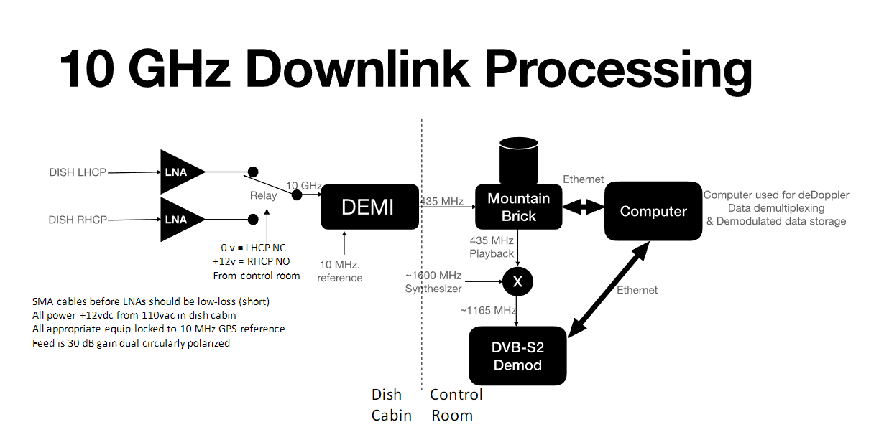
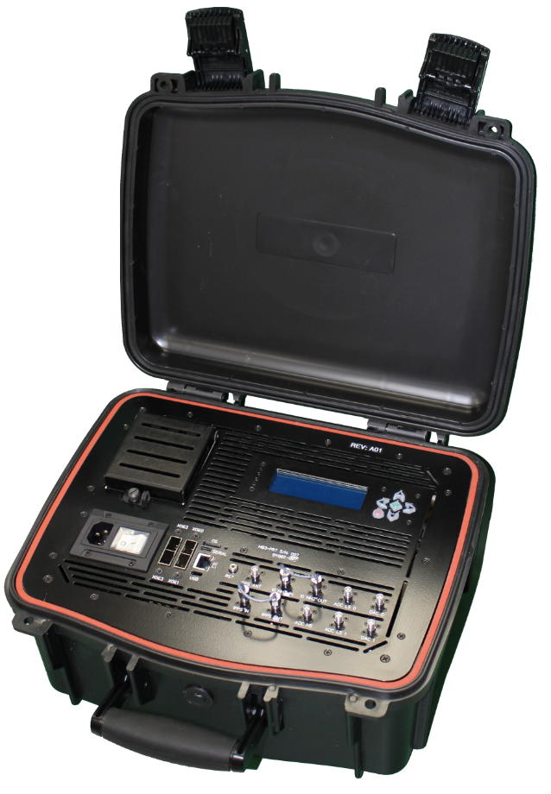
Downlink X-Band Ground Station
Image:
RRC MountainBrik Raid and Acquisition (MBRA)
Image:
6.1-meter radio telescope previously part of CARMA and BIMA arrays
Diagram: 10 GHz Downlink Processing by Dr. Mike Parker (RRC)
Notes:
One of my primary responsibilities this year, was to help facilitate the set-up and operations of CatSat’s X-band ground station. X-band communications concern receiving data and high-definition images/videos from CatSat’s 10GHz antenna (either its patch or inflatable antenna). This includes data collected by the WSPR antenna and HD Earth imaging, downlinked at ~10.47 GHz and down converted into a 435 MHz signal. (At higher frequencies, there is greater loss in coax, and it can be hard to work with, so we down convert the 10GHz signal to 435 MHz).
We originally did a survey of Biosphere 2, and we were working towards setting this station up for X-band communications. However, due to some programmatic delays in acquiring certain components and maintenance work, I re-initiated our coordination meetings with RRC for collaboration at the 6.1m dish at Tech Park in the interim.
The general objective for the 10GHz downlink processing can be described as follows:
Explanation:
CatSat passes over and downlinks at ~10.47 GHz.
Convert the 10.47 GHz signal into 435 MHz.
That signal/data is sent to a splitter, but one path goes to the Ayecka and the other to the MountainBrik (a high-performance RF recorder).
The Ayecka demodulates that information and sends it to the PC to be able to engage meaningfully with the data (like readable text or images). If for whatever reason the Ayecka was not locked on during that pass, the MountainBrik will act as a backup and replay the signal to the Ayecka so it can lock onto CatSat’s signal for future passes.
--------------------------------------------------------------------------------------------------------------------------------------------------
*Note: MB has a built-in synthesizer to mix the 435 MHz to 1164 MHz since Ayecka receives frequencies at L-band.
Ayecka was originally used for satellite TV w/ geostationary (GSO) satellites. It would “lock” onto the signals of these GSO satellites. However, it can lose lock of the signal if the signal is off due to something like the doppler effect or the fact that CatSat will be in a low earth sun-synchronous orbit.
CatSat is not a GSO satellite, so there can be issues with the Ayecka locking onto CatSat’s signal as it passes overhead. Since we might only get on 5-8-minute pass every 6 hours, it is important the Ayecka (our demodulator) doesn’t get “unlocked.” Losing lock makes it hard to lock back onto the satellite’s frequency.
Lock – on and decoding, unlocked – off and not decoding

Slide 8
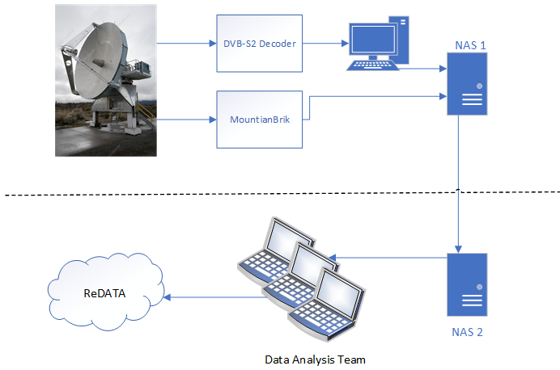
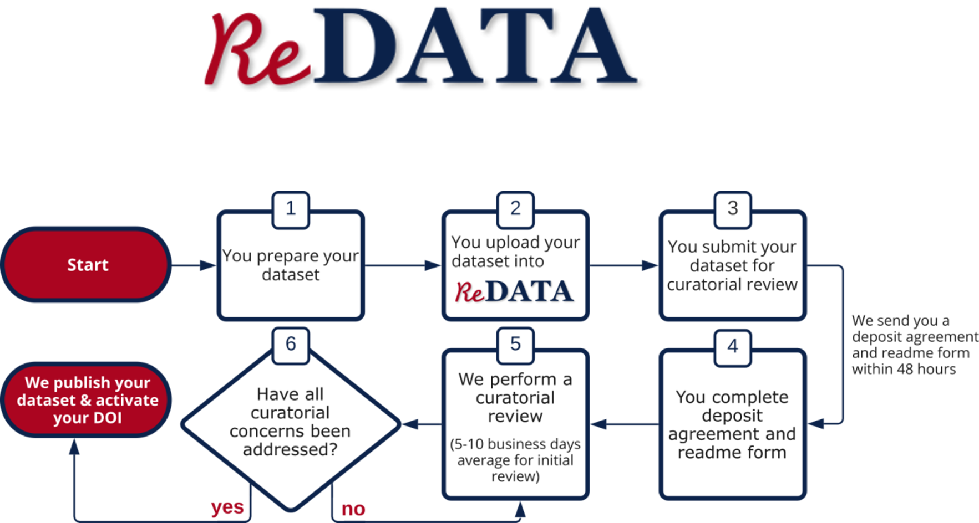
Preliminary Science Operations
Diagram: ReData | Data Cooperative Website (2024)
Diagram: CatSat Data Flow by Hilly Paige (RRC)
Notes:
Just recently, several students on CatSat’s communication team, including myself, were tasked with helping define preliminary science operations for the program.
An initial outline for this process was designed for us by Hilly Paige, the former program manager on CatSat and a current engineer at RRC.
The general premise for these steps include receiving signals at the X-band station and recording them with the MountainBrik (RF recorder).
These raw samples are fed into a software known as “Xmidas” which is an interactive environment for signal processing and analysis.
This is where effects from doppler-shift are processed out of the recording.
The de-dopplered recording is transferred back to the MountainBrik, where the MB sends the new recording to the Ayecka for demodulation.
This turns the data into packets (small units of data transmitted over a network).
Currently, the program envisions publishing the data acquired from CatSat (WSPR signals and HD imaging) through the University of Arizona Research Data Repository (ReDATA), which is the University’s official repository for publicly archiving and sharing research materials such as data, code, images, videos, etc. ReData provides a fantastic opportunity to train students on both how to use the platform and uploading data from the program.
---------------------------------------------------------------------------------------------------------------------------------------------------------
Notes:
Doppler shifts in satellites refer to the change in frequency of signals received from a satellite due to relative motion between the satellite and the receiving station. Analogous to a train whistle whereas the train gets closer to you, the waves get closer, and whistle sounds and vice versa as the train gets fartjer.

Slide 9
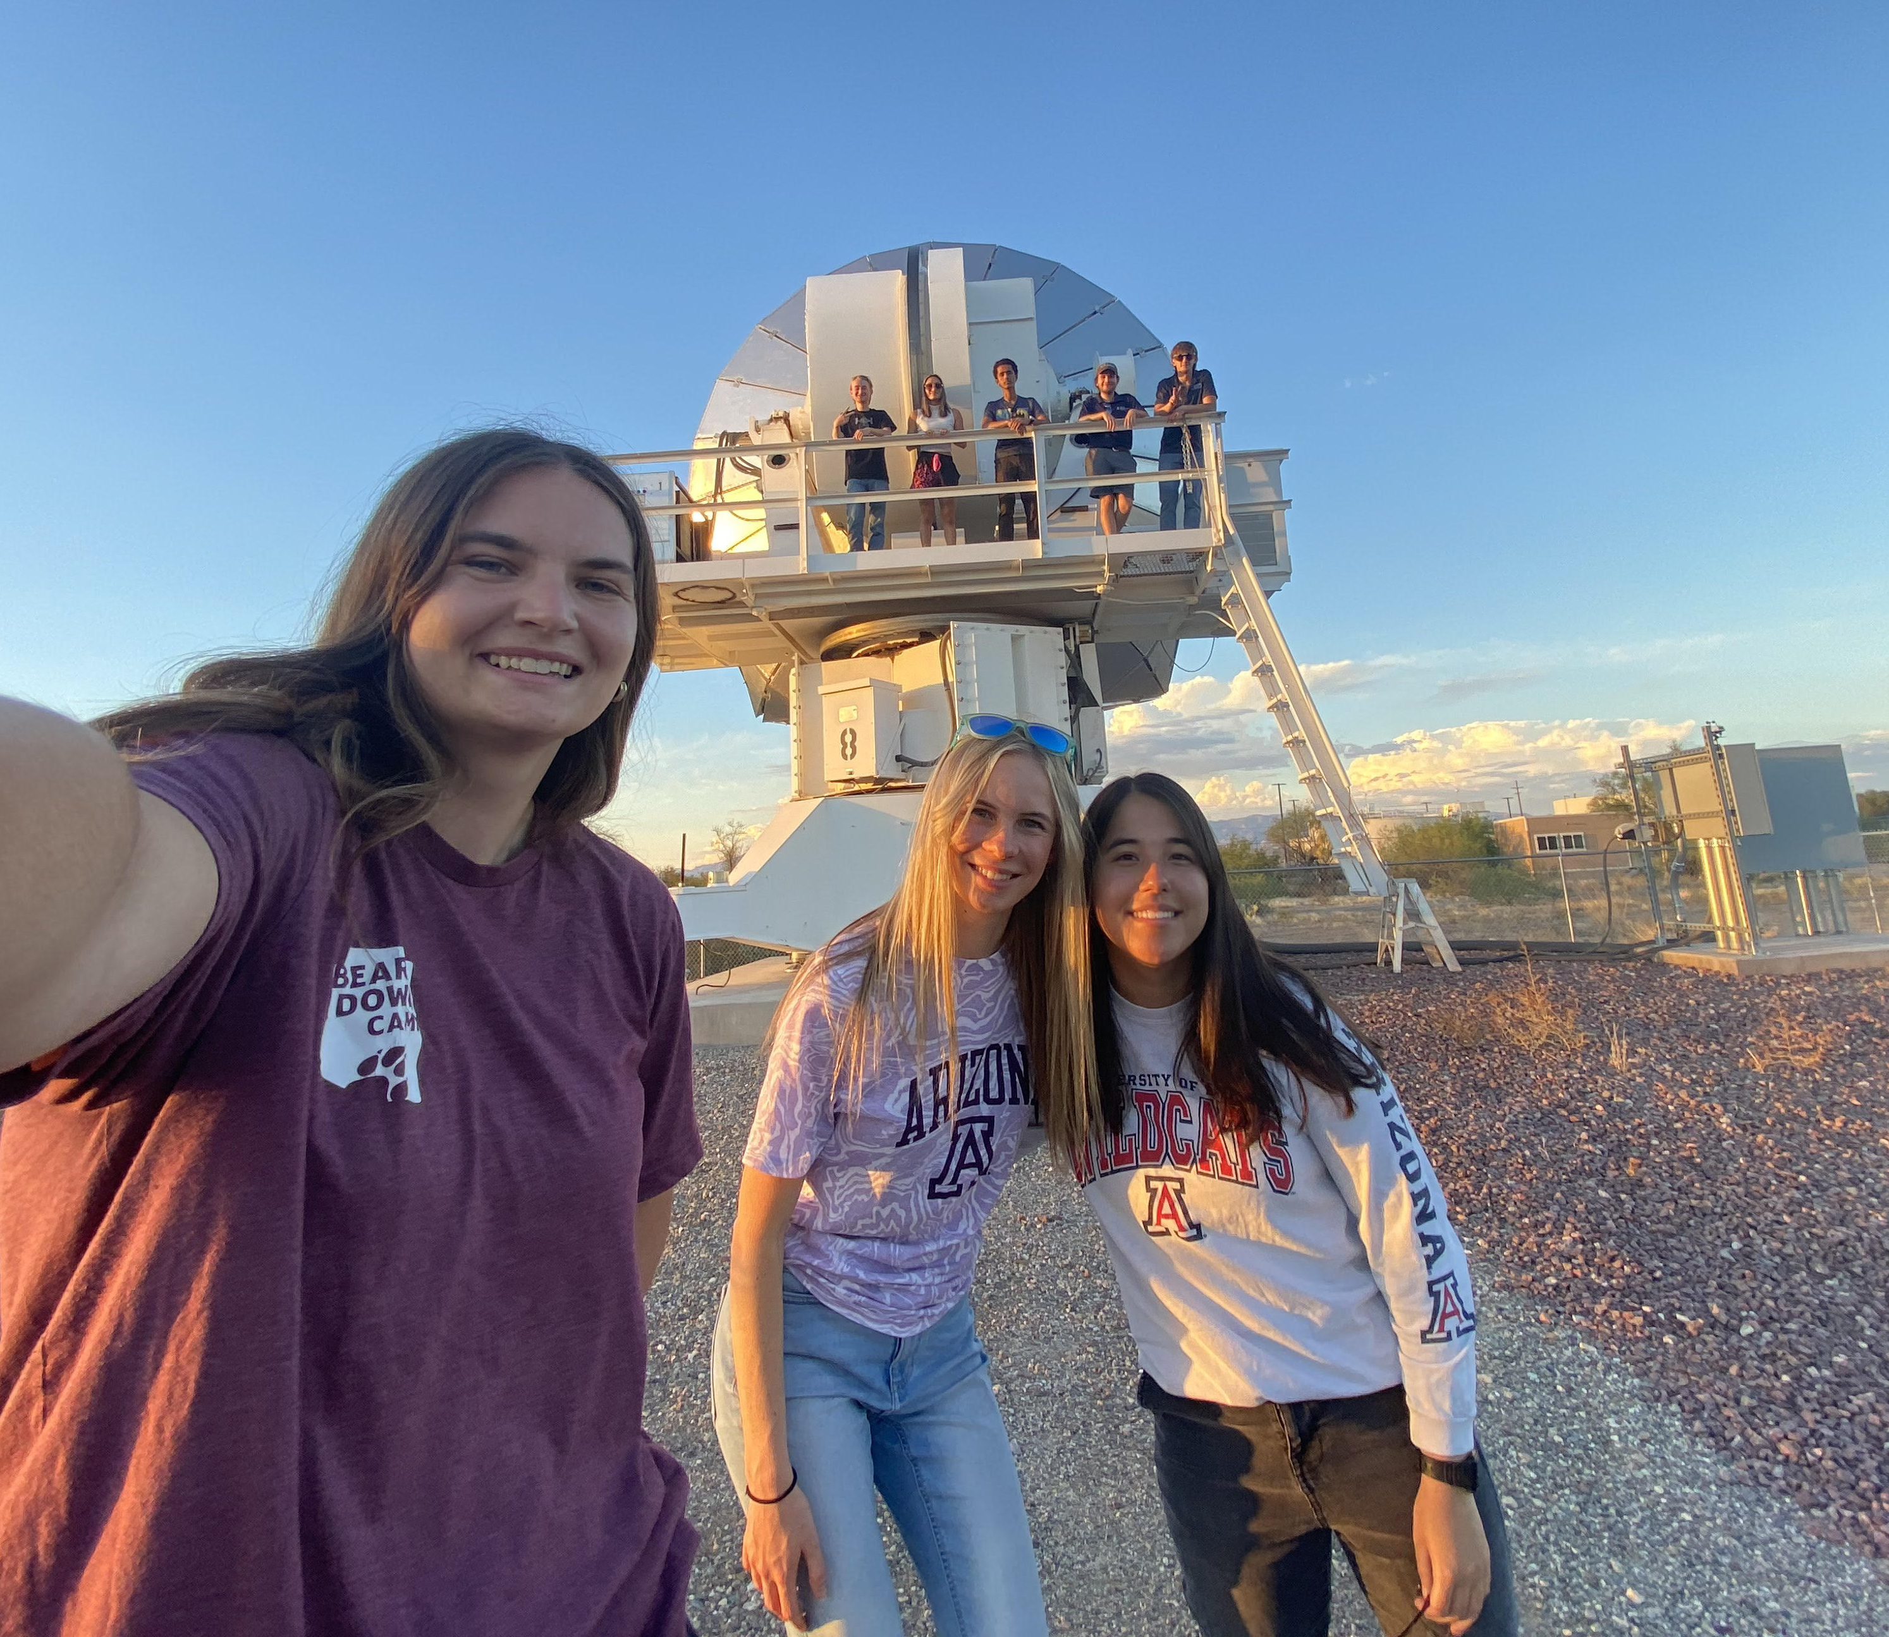
Ongoing Work
Continuing to train students for operations.
  Transitioning from in-person to remote operations.
  Learning how to process and publish data to ReData.
Finalizing UHF and X-band ground stations.
  Finish tests and the control room setup at the ARB.
  Finishing Biosphere 2 maintenance and set-up.
  Continuing coordination meetings between RRC/UA.
Providing educational opportunities for the team and the community.
Image: Training at Tech Park for X-band operations
Notes:
At the time of this presentation, there is still ongoing work for the program.

Slide 10
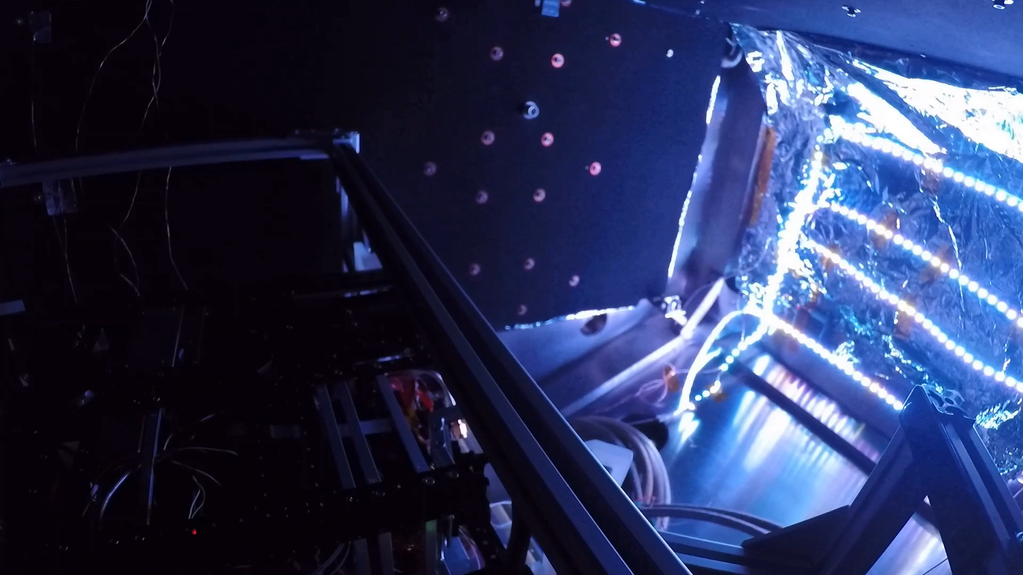
Significance and Future Impact
“If You Build It, They Will Come…”
Utilize novel inflatable antenna technology to enable high-bandwidth communications for future small satellite missions.
Conduct research on Earth’s ionosphere through the WSPR experiment and publicize data.
Foster collaboration between academia, industry, and government agencies.
Hands-on experience with mission operations, ground communications, and data analysis fosters the development of future scientists and engineers.
Video: Deployment of CatSat’s inflatable antenna using the TVAC chamber at Drake (2022)
Notes:
Shared with me that the program has often operated under the following quote.
By demonstrating CatSat’s technologies, we opens the doors to enhanced data transmission capabilities for small satellites.
Further, the data we collect and share with the public will continue to foster collaboration between academia, industry, and government agencies.
Finally, at its core, CatSat has afforded students the opportunity to work on a real-world, hands-on project, training the next generation of scientists and engineers.

Slide 11
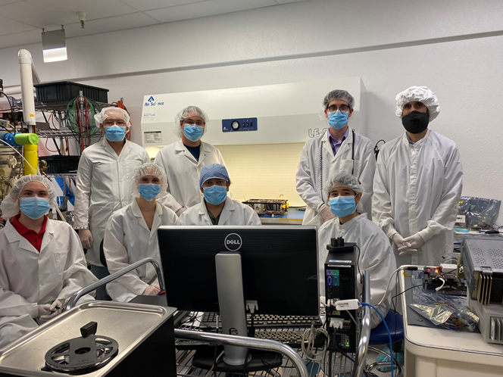
Acknowledgements
  Thank you to…
  Dr. Christopher Walker
  UA’s CatSat Team
  Arizona NASA Space Grant Consortium
  NASA CubeSat Launch Initiative
  Rincon Research Corporation
  FreeFall Aerospace
  Firefly Aerospace
Image: UA Communications (2022)

Slide 12
Thank You!

